Slide 1

Arabic Letters Made Fun: Engaging Activities for Parents & Children
Transform Arabic learning into joyful adventures that bring families together through play, creativity, and discovery.

Slide 2
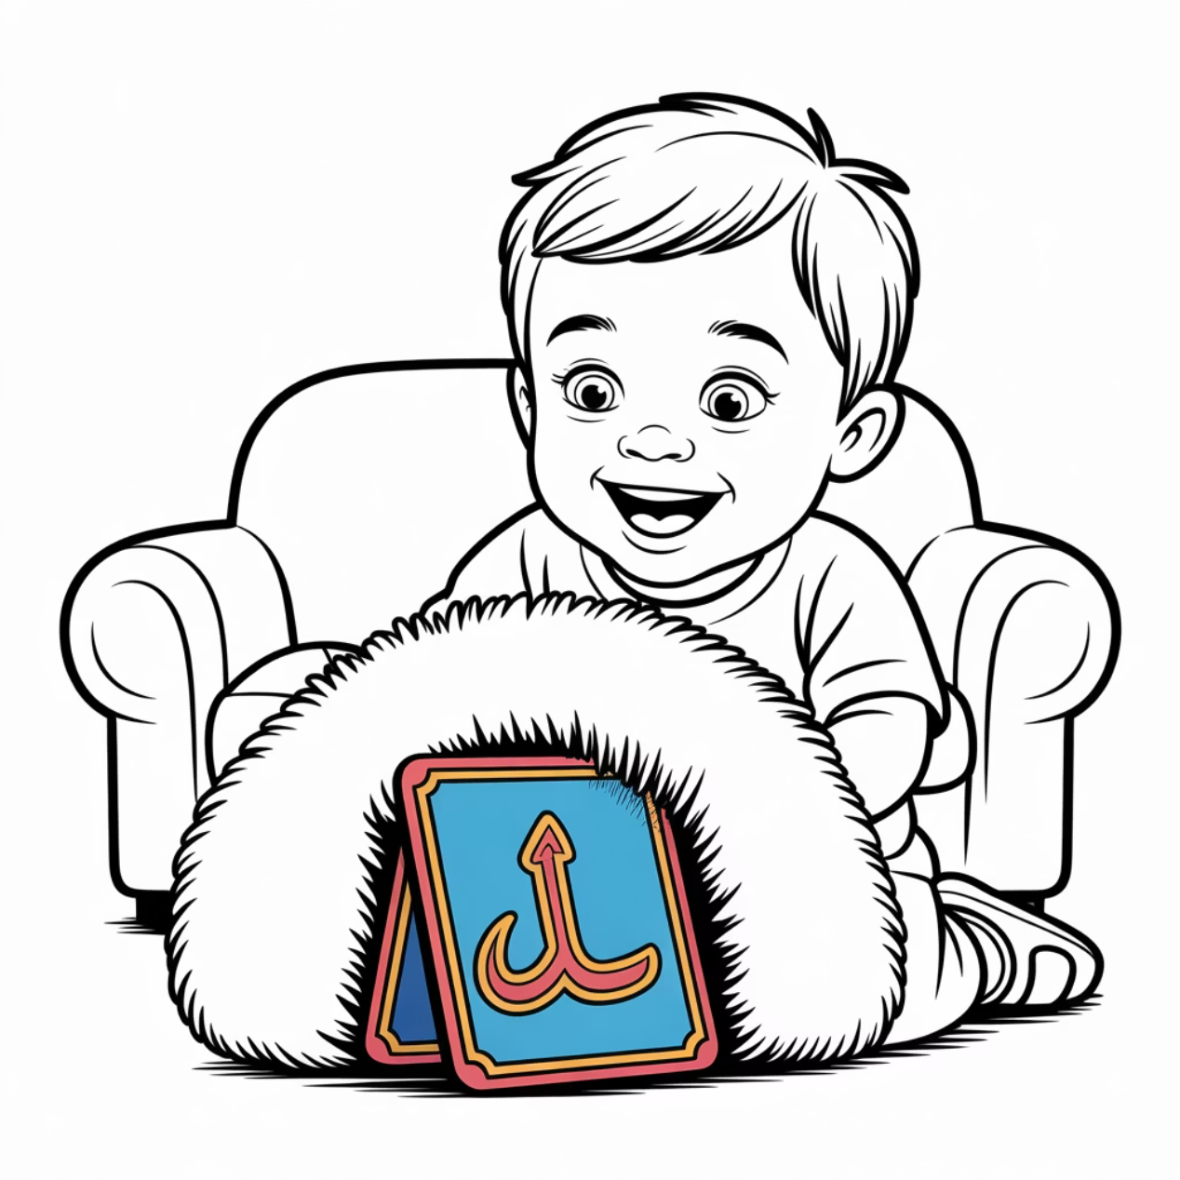
Alphabet Treasure Hunt
Hide colourful cards with Arabic letters around your home. Each time your child finds a card, they say the letter and its sound aloud.
Perfect for Arabic A children to playfully connect speech and letters, and Arabic B children to link movement with sounds.
Creates excitement around letter discovery
Combines physical activity with learning
Builds confidence through success

Slide 3
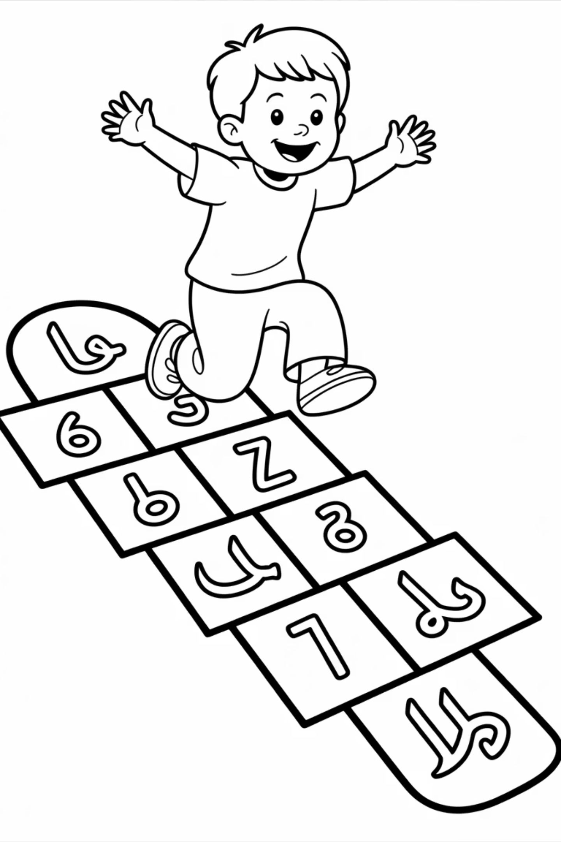
Harakat Hopscotch: Jump Into Vowels!
Draw the Grid
Call & Jump
Create hopscotch squares labelled with َ (fatha), ِ (kasra), ُ (damma)
Say a word; your child jumps to the vowel sound they hear
Learn Through Play
Transforms abstract vowel marks into lively, memorable games

Slide 4

Letter Art & Crafts: Hands-On Learning
Shape Arabic letters using clay, sand, or string. Tactile activities help children, especially Arabic B learners, transform unfamiliar shapes into friendly, memorable forms.
Benefits Include:
Encourages creativity and artistic expression
Builds muscle memory for letter formation
Makes abstract symbols tangible and familiar
Develops fine motor skills alongside literacy

Slide 5
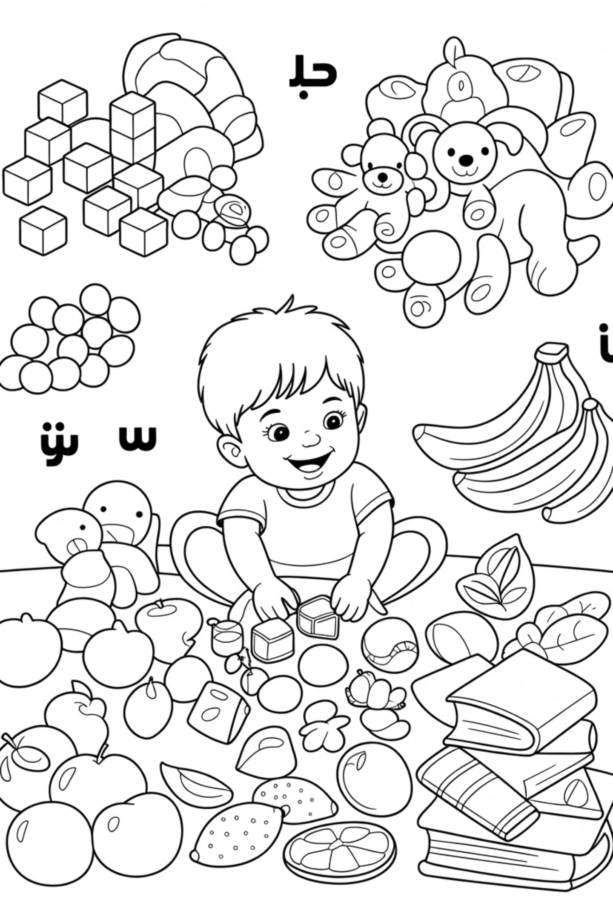
Sound Sorting: Discover Letters in Everyday Life
01
02
Collect Objects
Group & Say
Gather household items starting with the same letter, like ب (ball, banana, book)
Children sort objects and say the words aloud, sharpening listening skills
03
Build Vocabulary
Shows that Arabic words surround them in daily life, making learning relevant

Slide 6

Silly Sentences for Fun: Laugh & Learn
Try This Example:
"بطة بيضاء بكت بجوار بيت كبير"
("A white duck cried next to a big house")
Children enjoy laughter whilst practising sounds and sentence rhythm. This approach lightens learning for Arabic A families and introduces rhyme playfully for Arabic B learners.

Slide 7

Family Flashcards: Learning Close to Heart
Personalise flashcards with names of family members, pets, or favourite places. This makes letters meaningful and motivates children to learn words that truly matter to them.
Why Personalisation Works:
Connects literacy to daily life and love
Increases emotional investment in learning
Creates memorable associations

Slide 8
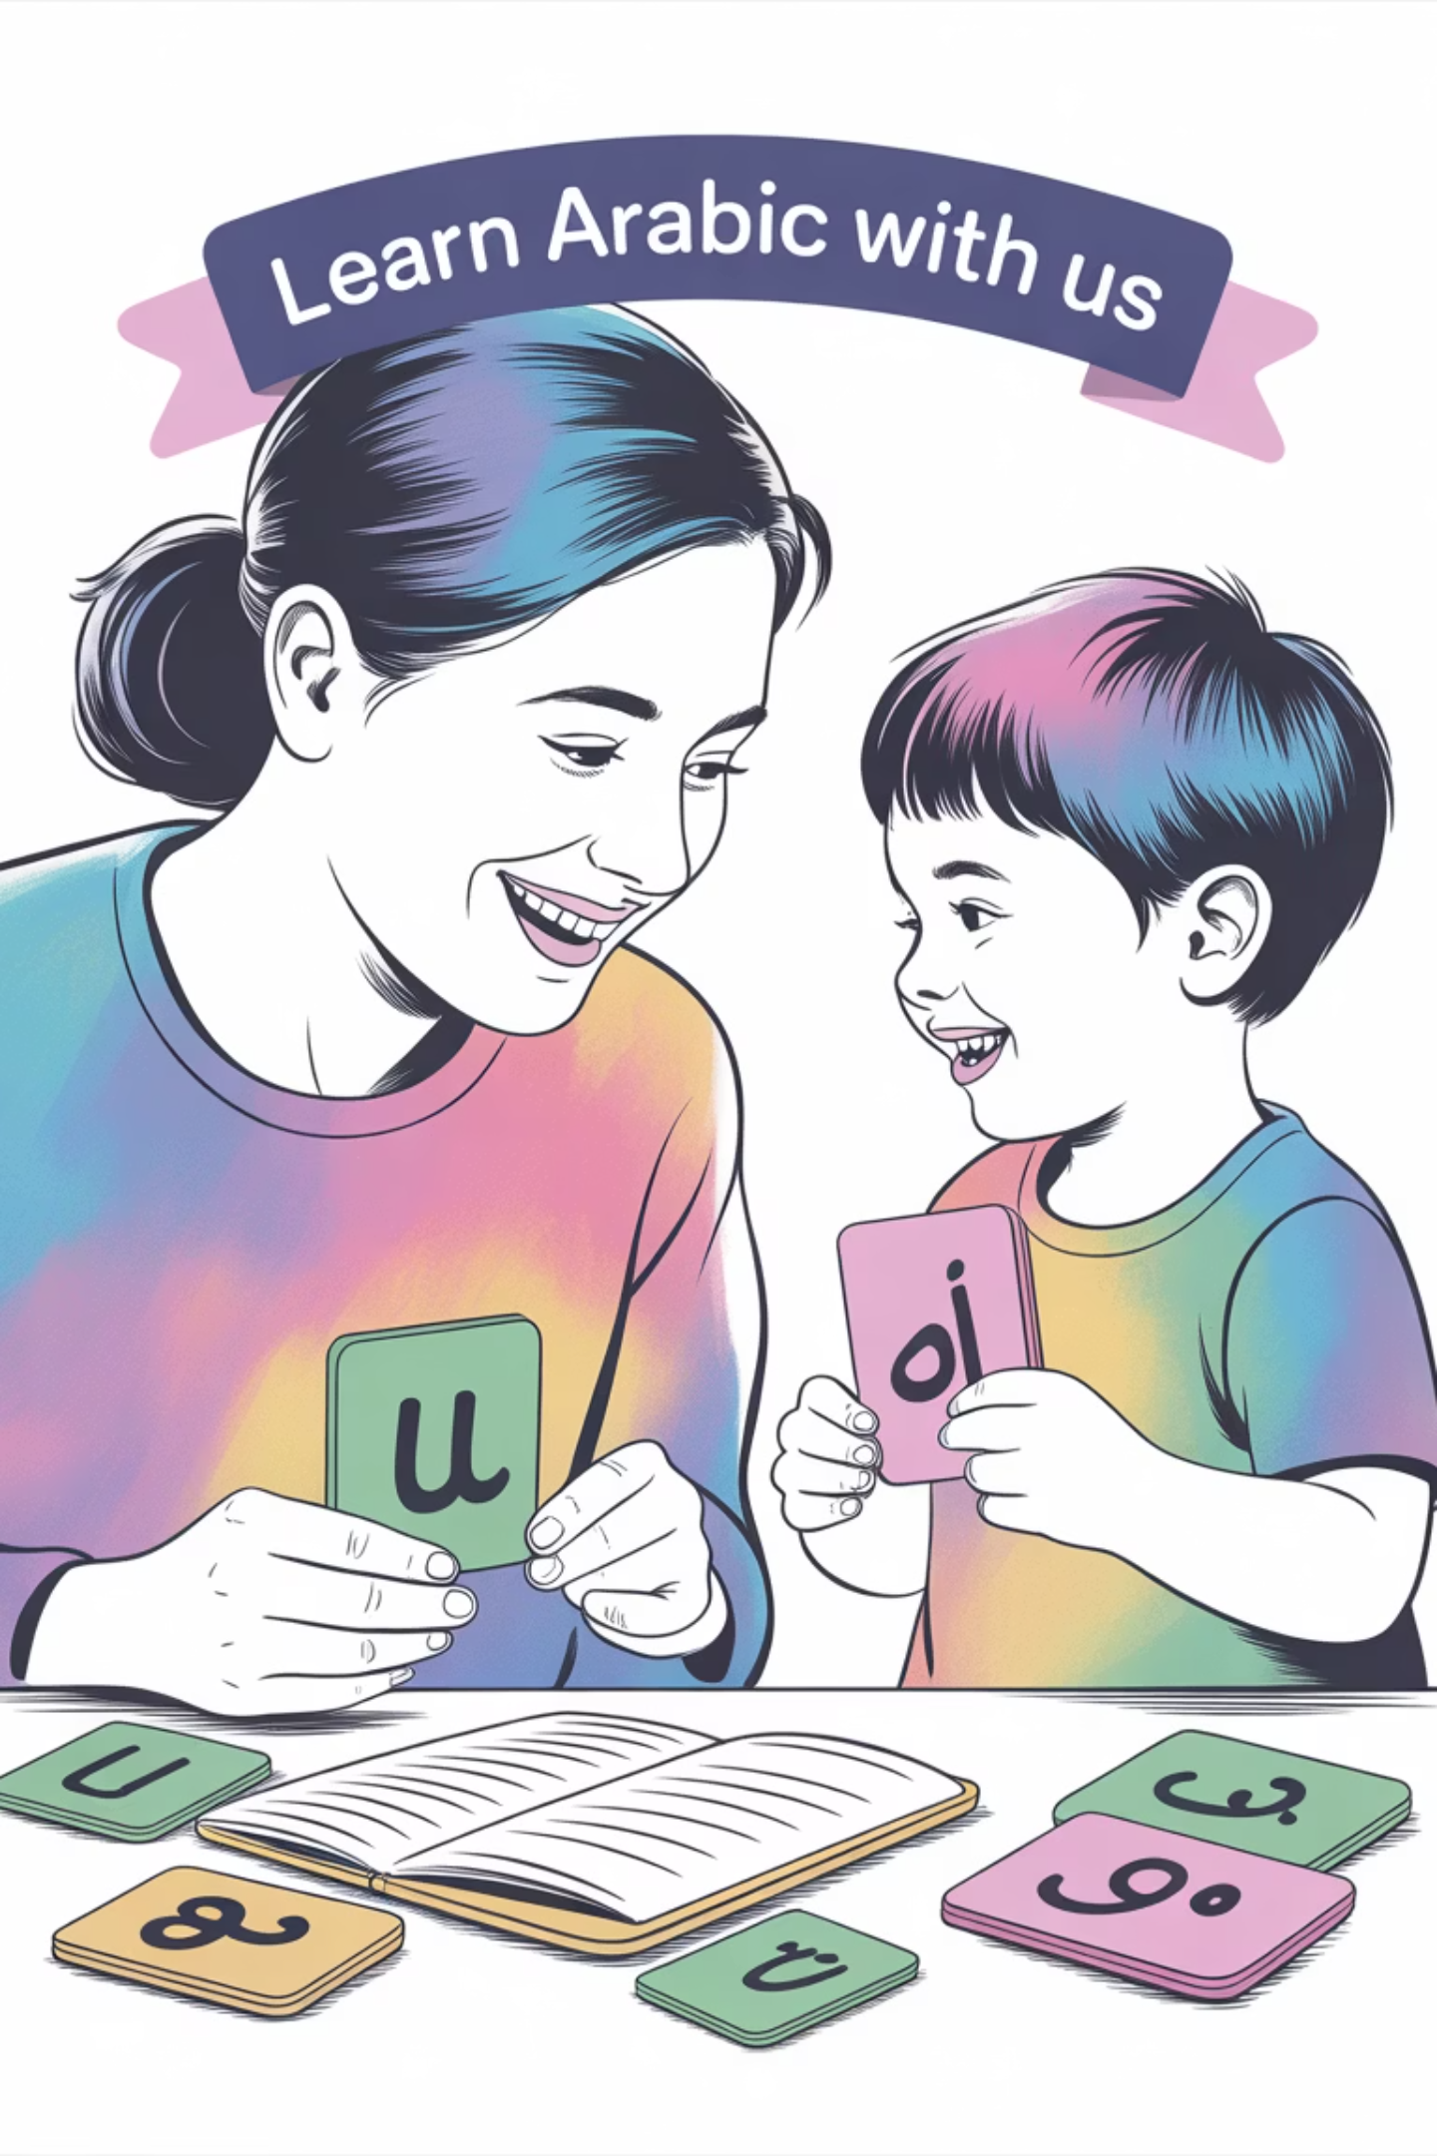



Why These Activities Work
Multiple Learning Styles
Combine movement, touch, sound, and laughter to engage different ways of learning effectively
Build Confidence
Make Arabic letters approachable and enjoyable, removing fear and building positive associations
Family Connection
Encourage parents to participate, creating joyful shared learning moments that strengthen bonds

Slide 9

Bonus Tips for Arabic Parents
Keep It Short
Maintain brief, playful sessions to preserve your child's interest and enthusiasm
Celebrate Wins
Acknowledge small achievements to boost motivation and build lasting confidence
Use Visual Anchors
Employ colourful visuals and familiar objects to make abstract concepts concrete
Mix Activities
Adapt to your child's unique learning style by varying approaches and methods

Slide 10


Final Thought: Joyful Journeys to Arabic Fluency
Making Arabic letters active, colourful, and connected to home life transforms learning into a joyful adventure. From recognition to fluency, children thrive when learning feels like play.
Let's inspire our children to love Arabic, one fun activity at a time! When we combine creativity with learning, we open doors to lifelong appreciation for this beautiful language.

